Slide 1
SPEECH ONSET AND OFFSET DETECTION USING VIDEO STREAM
Project Members
N.THANIGAIVEL
S.S. RAHUL RANGARAJAN
G. RAHUL KUMAR
312213106111
312213106315
312213106314
Project Guide
Dr. R.Rajavel, Associate Professor / ECE

Slide 2
OUTLINE
Motivation
Objective
Separation of audio from AV
Smoothing and normalizing the audio stream
Onset and offset detection from the audio stream
Mouth detection using bounding box
Conversion of RGB to HSV color space
Onset and offset detection from the video stream
Audio onset and offset detection at various SNR
Performance
References

Slide 3
MOTIVATION
When the SNR is high, speech is dominant compared to noise, thus it is more reliable to detect onsets and offsets from audio stream itself.
But when the SNR is very low, noise is dominant compared to speech, thus it is more reliable to detect onsets and offsets from video stream compared to audio.
The onset and offset times of video stream can be detected by tracking the lip movement of the target speaker.
The detected onset and offset time of the video stream is then plotted against that of audio stream, so that they have a one-to-one relationship.

Slide 4
OBJECTIVE
To determine the onset and offset from the video stream.
To determine the onset and offset from the audio stream.
To match the detected onset and offset of video and audio streams.

Slide 5
ONSET AND OFFSET DETECTION
Mouth detection
Lip movement tracking
Onset and Offset detection
Video
The onset and offset detected from video stream is compared with that of audio to check one to one correspondence
Speech Separation
Visual Speech
(Audio+video)
Audio – For comparison
Normalizing To Get Max. Value
Onset and Offset detection
Smoothing

Slide 6

AUDIO-VIDEO INPUT

Slide 7

VIDEO(2 SEC)
EXTRACTED AUDIO FROM AV
AUDIO(2 SEC)

Slide 8
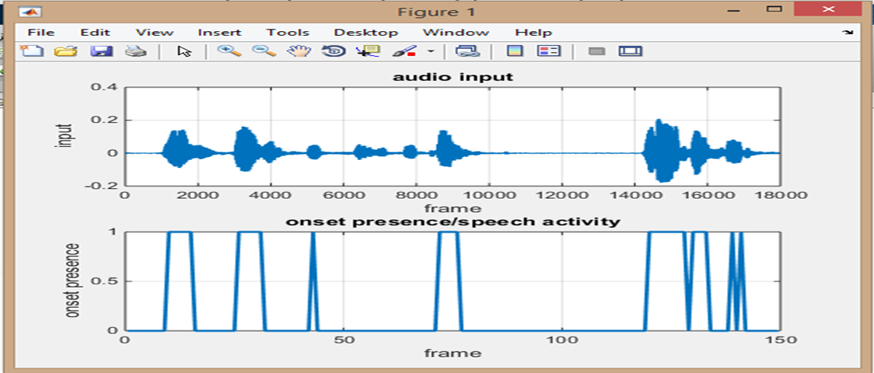
AUDIO SPEECH INPUT

Slide 9
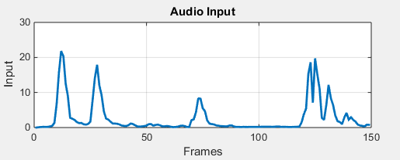
ONSET AND OFFSET-AUDIO
AV Input
Extracted
audio (2 sec)
Smoothing

Slide 10
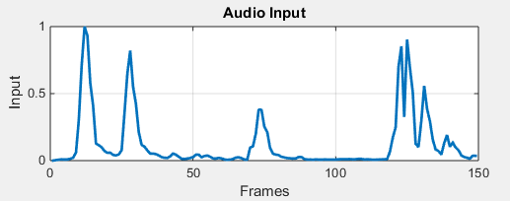

Normalizing to get max. value
Zero - Region between offset of one candidate to onset of next candidate.
One – Region between onset of one candidate to offset of some candidate.
Determining
onset and
offset position
Plot graph

Slide 11
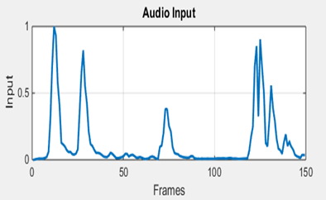
AUDIO OUTPUT
Smoothing:
Normalization:

Slide 12
ONSET AND OFFSET OF AUDIO STREAM

Slide 13
VIDEO SPEECH INPUT

Slide 14
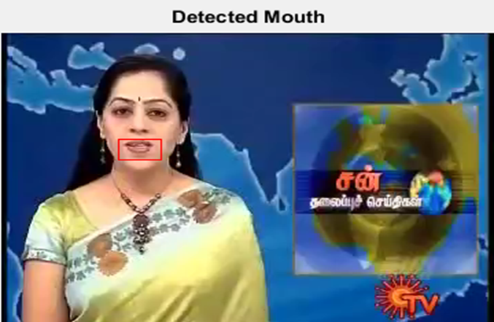
MOUTH DETECTION USING BOUNDING BOX
Target Speaker
Bounding Box

Slide 15
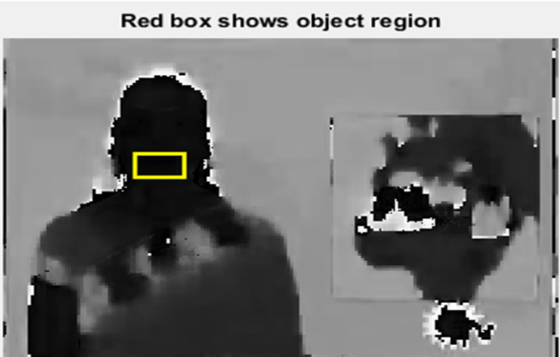
HUE CHANNEL DATA
RGB to HSV
colour space

Slide 16
FLOWCHART-VIDEO
AV Input
BB-Bounding Box
Extracted
Video (2 sec)
Applying BB
to mouth
Bounding Box
Convert RGB
to HSV
Get the skin tone
information

Slide 17
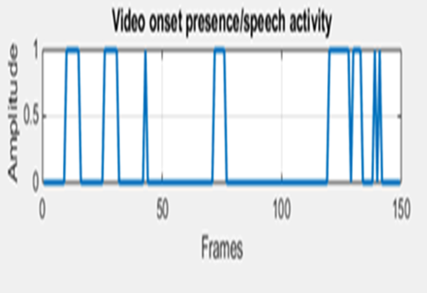
Histogram
based
tracker
Zero- If there is no speech
activity
Non-zero- Presence of speech
activity
Successive
matrix
subtraction
Mapping onset
and
offset

Slide 18
VIDEO OUTPUT

Slide 19
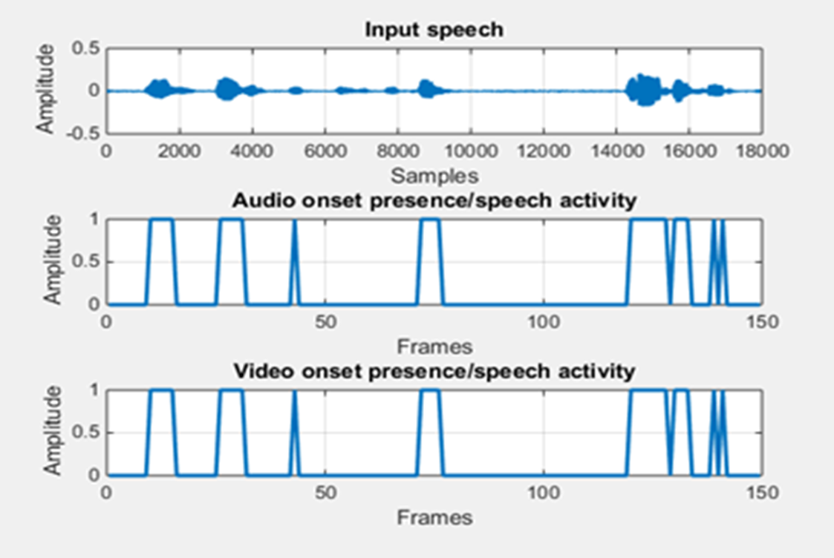
COMPARISON

Slide 20
ADDITION OF NOISE

Slide 21
ADDITION OF NOISE

Slide 22
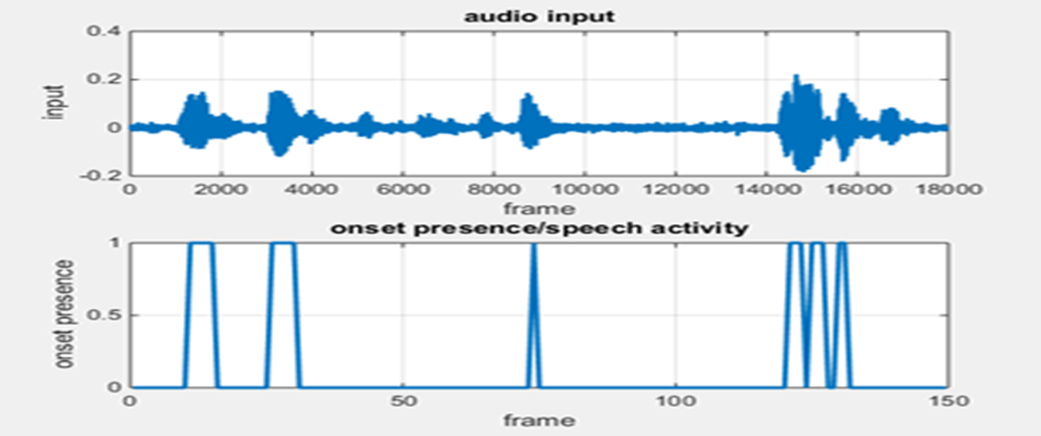
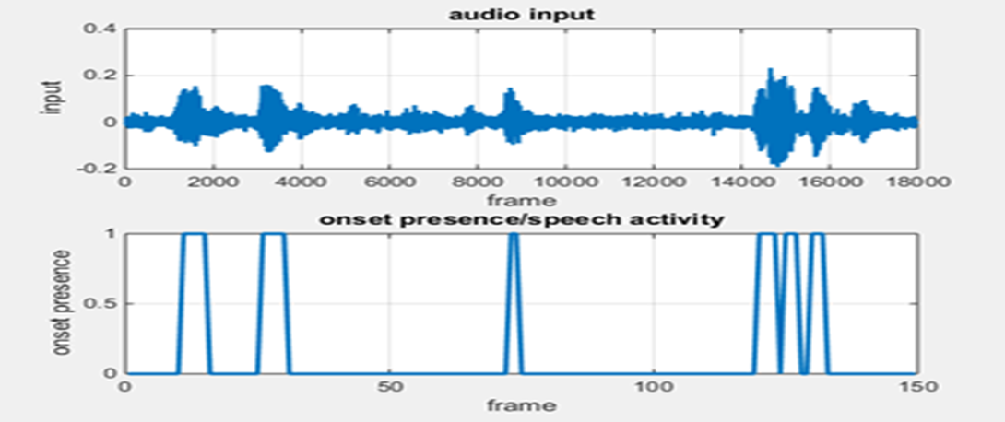
DETECTION AT VARIOUS SNR
SNR = 10dB :
SNR = 5dB :

Slide 23
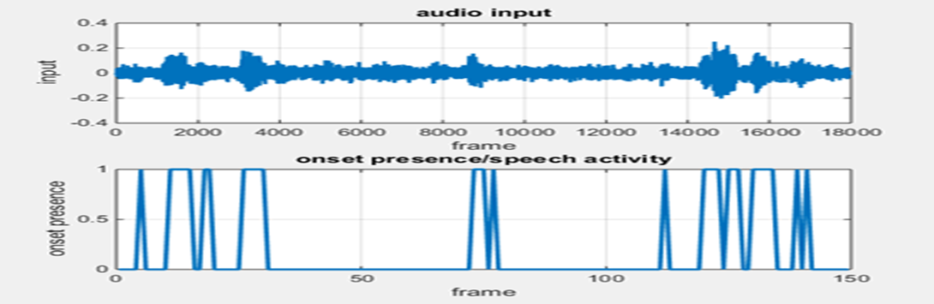
DETECTION AT VARIOUS SNR
SNR = 0dB :

Slide 24
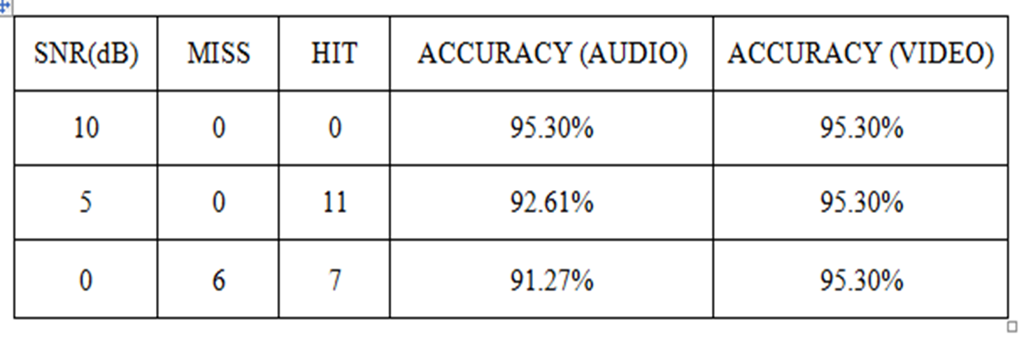
PERFORMANCE
Miss: A frame with onset presence is wrongly detected as an offset region
i.e., 1 is detected as 0.
Hit: A frame in the offset region is wrongly detected as an onset presence
i.e., 0 is detected as 1.
Accuracy can be calculated by
Accuracy=100- [(Miss+Hit) / Total number of frames]

Slide 25
LITERATURE SURVEY
Title | Author | Inference
Auditory Segmentation Based on Onset and Offset Analysis | Guoning Hu DeLiang Wang | The system smoothes the intensity to enhance the alignment of onsets and offsets. It detects onsets and offsets in each filter channel and then generates segments by matching corresponding onset and offset fronts.
Audio-Visual Speech Activity Detector | Hana Sarbortova | Lip activity detector estimates speech parts of a video from visual features. Canonical-Correlation Analysis(CCA) used as a test for synchrony.

Slide 26
Title | Author | Inference
Cardi Conversation Database (CCDb): A Database of Natural Dyadic Conversations | A.J. Aubrey et al. | A unique 2D audiovisual database containing natural conversation between pairs of people. It has been shown that non-verbal information.
Mel- FrequencyCepstralCoecient(MFCC) - a Novel Method for Speaker Recognition | A.Das,M.R.Jena,andK.K.Barik | Develop a speaker recognition system which can be recognize speaker from their speech.

Slide 27
WORKPLAN
 | AUG | SEP | OCT | NOV | DEC | JAN | FEB
Audio Based Segmentation and Grouping
Mat lab code for audio onset and offset detection
Video based onset and offset detection
One-to-one mapping of audio and video stream

Slide 28
REFERENCE
[1] Guy J. Brown and Martin Cooke. (1994) ‘Computational Auditory Scene Analysis’, Computer speech and language Vol. 8, pp 297-336.
[2] Guoning Hu and DeLiang Wang. (2006) ‘An Auditory Scene Analysis Approach to Monaural Speech Segregation’, The Ohio State University, Department of Computer Science and Engineering and Center for Cognitive Science Columbus, OH 43210.
[3] Guoning Hu and DeLiang Wang. (2007) ‘Auditory Segmentation Based on Onset and Offset Analysis’, IEEE Transactions on Audio, Speech, and Language Processing, VOL. 15, pp NO. 2,
[4] Hana Sarbortova. (2015) ‘Audio-Visual Speech Activity Detector’, Ing. Jan Cech, PhD.
[5] A.J. Aubrey et al.(2013) ‘Cardi Conversation Database (CCDb): A Database of Natural Dyadic Conversations’. In: V & L Net Workshop on Language for Vision.
[6] Guoning Hu and DeLiang Wang. (2010) ‘A Tandem Algorithm for pitch Estimation and Voiced Speech Segregation’, IEEE Transactions on Audio, Speech, and Language Processing, VOL. 18, pp NO. 8.
Notes:
28

Slide 29
[7] A.Das, M.R.Jena, K.K.Barik.(2014)‘Mel-Frequency CepstralCoecient(MFCC) - a Novel Method for Speaker Recognition’ In: Digital Technologies 1(1), pp. 1–3.
[8] Itzik Pima, Mayer Aladjem (2004) ‘Regularised Discriminant Analysis for Face Recognition’.

Slide 30
Thank you

